Slide 1
Test Driven Development
An On-stage Demonstration
@LlewellynFalco

Slide 2
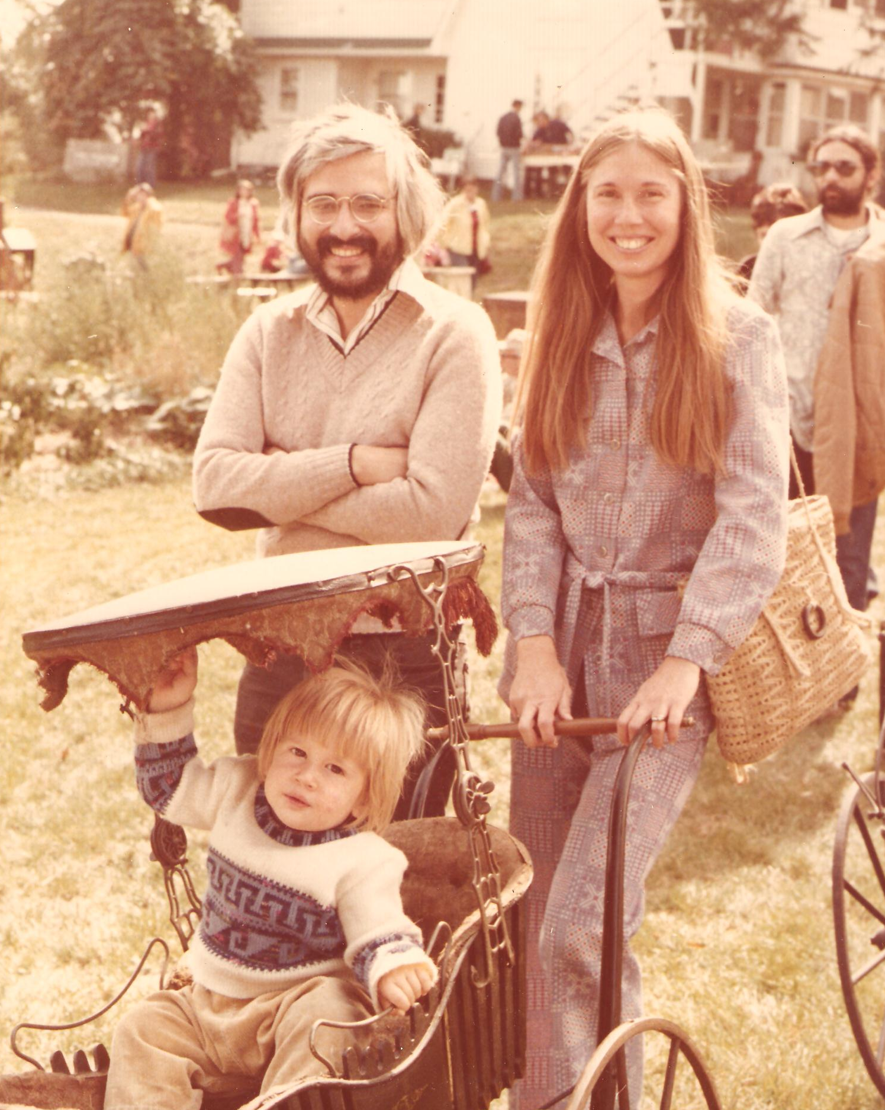
history…
A little

Slide 3

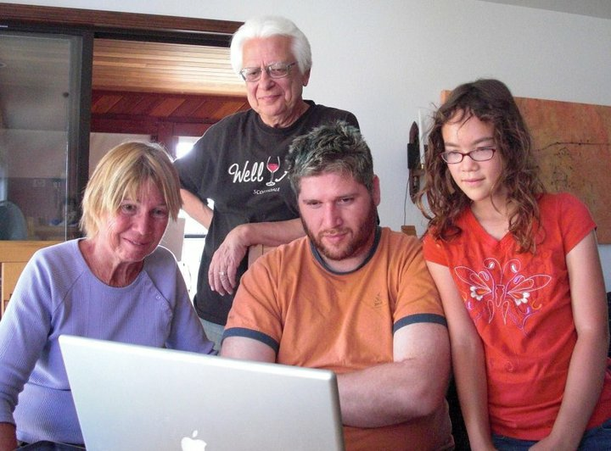

Slide 4
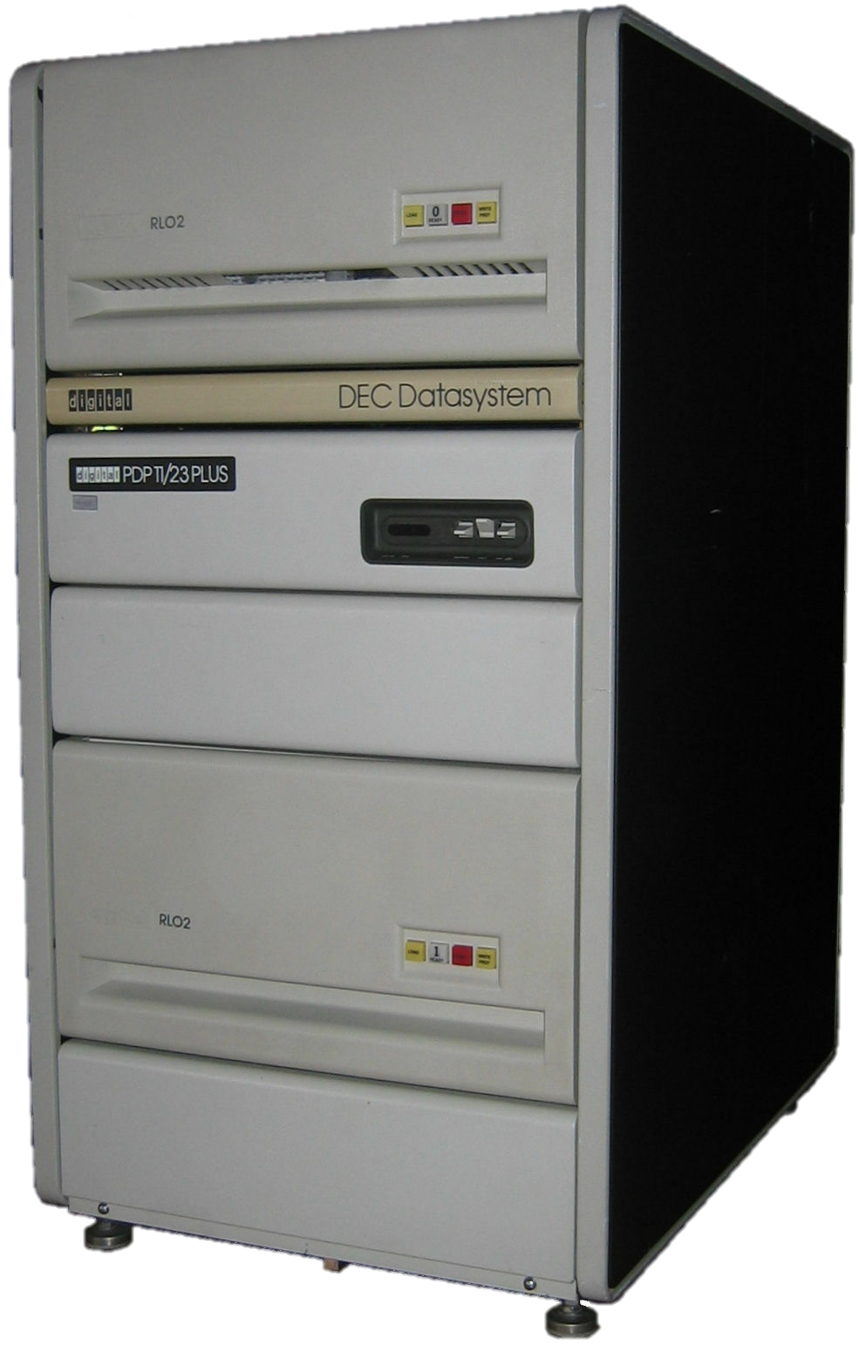
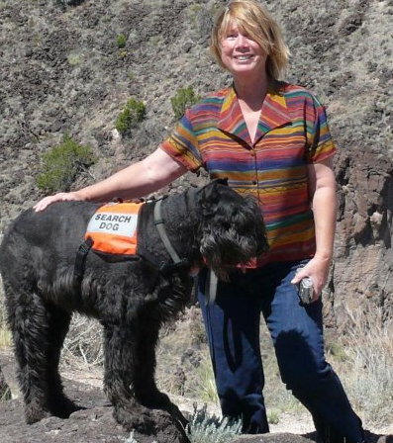

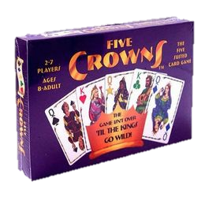


Slide 5


Slide 6
Is Testing Faster? (Test After)
60 Minutes
Work (code)
X minutes
Non-Work(tests)
<
Code
60 Minutes
Code + Test
60 + X minutes
Notes:
Both

Slide 7
Is Testing Faster? (Test 1st)
60 – Time Saved
30 Minutes
Work (code)
X minutes
Non-Work(tests)
<
?
Code
60 Minutes
Test + Code
X + 30 minutes
Notes:
Both

Slide 8
Today’s Kata: Triangle
A side has a distance
Side knows endpoints
3 points
3 sides
Perimeter
Get sides touching a point
Get side opposite a point
The angle of 2 sides touching a point
3 angles
Right Triangle
Notes:
Both

Slide 9
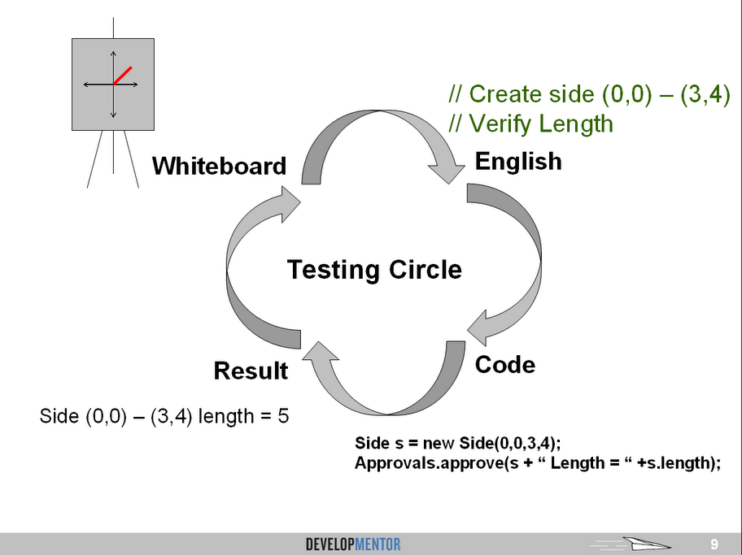

Slide 10
Parts of a Test
Do
Verify
Notes:
Both

Slide 11
Demo
Notes:
Both

Slide 12
Benefits of Unit Tests
Specification
Feedback
Regression
Granularity
Notes:
Both

Slide 13
Regression
A
A
If I used to get :
Then I still get :
Notes:
Both

Slide 14
Intentional Code
// Create a Side from (0,0) to (5,0)
var side = new Side(0,0,5,0);
Notes:
Both

Slide 15
7H15 M3554G3
53RV35 7O PR0V3
H0W 0UR M1ND5 C4N D0
4M4Z1NG 7H1NG5! 1MPR3551V3 7H1NG5!
1N 7H3 B3G1NN1NG 17 WA5 H4RD BU7
N0W, 0N 7H15 LIN3
Y0UR M1ND 1S R34D1NG 17
4U70M471C4LLY W17H 0U7 3V3N
7H1NK1NG 4B0U7 17,
B3 PROUD! 0NLY C3R741N P30PL3 C4N
R3AD 7H15.
U C4N R35D 7H15!!!

Slide 16
Consume 1st
Write the objects & methods you wish existed
Notes:
Both

Slide 17
Test Until Bored
Test the cases that bring you value
Notes:
Both

Slide 18
Verification
Is it the right answer?
Change the Question
Ask an expert
Notes:
Both

Slide 19
Completing the Circle
Your output should tell the story.
Objects should have ToStrings
Benefits
Specification
Feedback
Regression
Granularity
Notes:
Both

Slide 20
Fake it Till You Make It
Buys some time
Allows for Triangulation
Notes:
Both

Slide 21
Today’s Kata: Triangle
A side has a distance
Side knows endpoints
3 points
3 sides
Perimeter
Get sides touching a point
Get side opposite a point
The angle of 2 sides touching a point
3 angles
Right Triangle
Notes:
Both

Slide 22
Verifying Multiples
Verify Single:
Approvals.Verify(result);
Verify Many:
Approvals.VerifyAll(results, "label");
Notes:
Both

Slide 23
Multiple Cases
Approvals.VerifyAll(cases, c => TestWith(c));
Notes:
Both

Slide 24
Maintaining Tests
Same Quality as Production Code
Notes:
Both

Slide 25
Granularity of Test?

Slide 27

Resources
Test Driven Development: By Example
Kent Beck
Notes:
Both

Slide 28
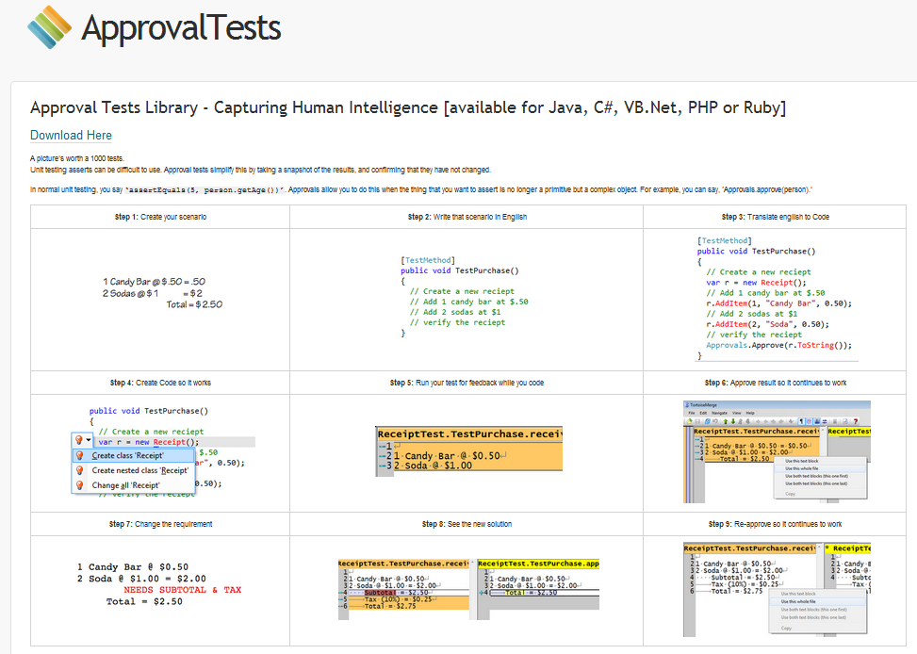
Resources
www.ApprovalTests.com (.net, java, php, ruby)
Herding Code Podcast
Notes:
Both

Slide 29
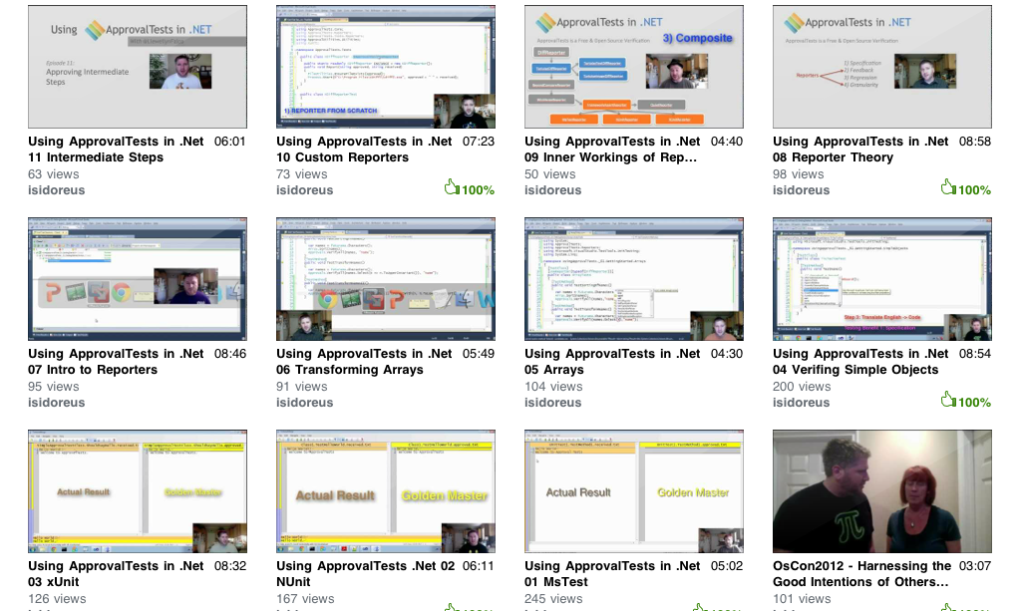
Resources
www.ApprovalTests.com (.net, java, php, ruby)
20 episode youtube series
Notes:
Both

Slide 30
Window Embedded Is Hiring!
Email: HeNakama@microsoft.com
or visit their booth upstairs

Slide 31

Resources
www.Develop.com
Intro To TDD Class (4 Day)
Legacy Code
Notes:
Both

Slide 32
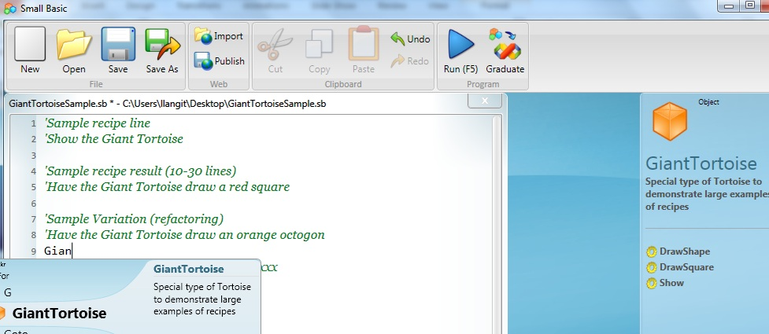
TeachingKidsProgramming.org
Do a Recipe → Teach a Kid (Ages 10 ++)
Microsoft SmallBasic, Java → Free Courseware (recipes)
Notes:
I add this slide at the end of EVERY presentation.

Slide 33

Please fill out evaluations: TDD – Demo #AW11
@LlewellynFalco http://LlewellynFalco.Blogspot.com
http://www.approvaltests.com
Notes:
Both

